Slide 1
ITMD 421 – Data Modeling and Applications
Aastha Gupta
Lecture 6
October 2nd, 2017

Slide 2
Objectives
Data Manipulation laguage
SELECT Operations
GROUP BY clause

Slide 3
SQL Statements - Categories
Data Manipulation Language (DML)
SELECT
Data Control Language
GRANT
INSERT
UPDATE
DELETE
MERGE
Data Definition Language (DDL)
CREATE
ALTER
DROP
RENAME
TRUNCATE
COMMENT
REVOKE
Transaction Control
COMMIT
ROLLBACK
SAVEPOINT

Slide 4
Data Manipulation Language
A DML statement is executed when you:
Add new rows to a table
Modify existing rows in a table
Remove existing rows from a table
A transaction consists of a collection of DML statements that form a logical unit of work.

Slide 5
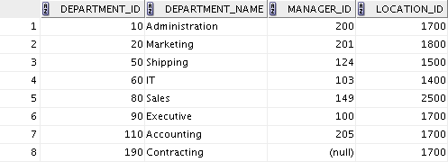
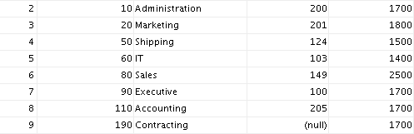
Adding a New Row to a Table
DEPARTMENTS
New
row
Insert new row into the DEPARTMENTS table.

Slide 6
INSERT Statement Syntax
Add new rows to a table by using the INSERT statement:
With this syntax, only one row is inserted at a time.
INSERT INTO table [(column [, column...])]
VALUES (value [, value...]);

Slide 7

Inserting New Rows
Insert a new row containing values for each column.
List values in the default order of the columns in the table.
Optionally, list the columns in the INSERT clause.
Enclose character and date values within single quotation marks.

Slide 8
Inserting Rows with Null Values
Implicit method: Omit the column from the column list.
Explicit method: Specify the NULL keyword in the VALUES clause.

Slide 9
Inserting Special Values
The SYSDATE() function records the current date and time.
INSERT INTO employees (employee_id,
first_name, last_name,
email, phone_number,
hire_date, job_id, salary,
commission_pct, manager_id,
department_id)
VALUES (113,
'Louis', 'Popp',
'LPOPP', '515.124.4567',
CURRENT_DATE, 'AC_ACCOUNT', 6900,
NULL, 205, 110);

Slide 10
Inserting Specific Date and Time Values
Add a new employee.
INSERT INTO employees
VALUES (114,
'Den', 'Raphealy',
'DRAPHEAL', '515.127.4561',
TO_DATE('FEB 3, 2003', 'MON DD, YYYY'),
'SA_REP', 11000, 0.2, 100, 60);

Slide 11
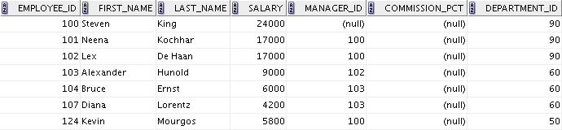
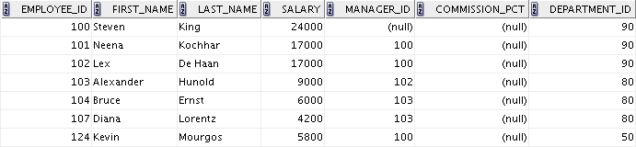
Changing Data in a Table
EMPLOYEES
Update rows in the EMPLOYEES table:

Slide 12

UPDATE Statement Syntax
Modify existing values in a table with the UPDATE statement:
Update more than one row at a time (if required).

Slide 13
Updating Rows in a Table
Values for a specific row or rows are modified if you specify the WHERE clause:
Values for all the rows in the table are modified if you omit the WHERE clause:
Specify SET column_name= NULL to update a column value to NULL.
UPDATE employees
SET department_id = 50
WHERE employee_id = 113;
UPDATE copy_emp
SET department_id = 110;

Slide 14
Updating Rows in a Table
UPDATE Store SET city= ’Bohston’ WHERE city = ‘Boston’;
Updates Boston tuples to new spelling
UPDATE Store SET city= 'Boston' WHERE city LIKE 'B%ton';
Set “Boston” spelling
Includes “Boston”, “Bohston” and even “Brighton”

Slide 15
Updating Rows in a Table
UPDATE Savings
SET Amount = Amount * 1.2
WHERE accountType = ‘CD’;
UPDATE Checking
SET Amount = Amount * 1.04
WHERE Amount > 50;

Slide 16

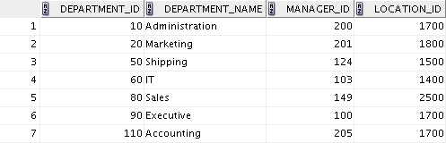
Removing a Row from a Table
DEPARTMENTS
Delete a row from the DEPARTMENTS table:

Slide 17
DELETE Statement
You can remove existing rows from a table by using the DELETE statement:
DELETE [FROM] table
[WHERE condition];

Slide 18
Deleting Rows from a Table
Specific rows are deleted if you specify the WHERE clause:
All rows in the table are deleted if you omit the WHERE clause:
DELETE FROM departments
WHERE department_name = 'Finance';
DELETE FROM copy_emp;

Slide 19
Basic SELECT Statement
SELECT identifies the columns to be displayed.
give a single attribute, or a list
* for all attributes
DISTINCT will only report distinct tuples
FROM identifies the table containing those columns.
SELECT *|{[DISTINCT] column [alias],...}
FROM table;

Slide 20
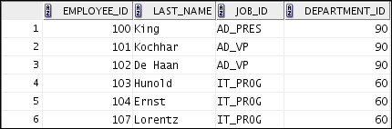

Limiting Rows by Using a Selection
EMPLOYEES
…
“retrieve all employees in department 90”

Slide 21
Limiting Rows That Are Selected
Restrict the rows that are returned by using the WHERE clause:
The WHERE clause follows the FROM clause.
SELECT *|{[DISTINCT] column [alias],...}
FROM table
[WHERE logical expression(s)];

Slide 22
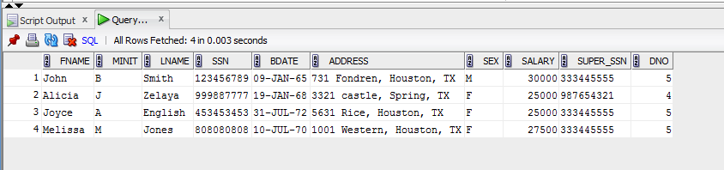
BETWEEN Operator
Use the BETWEEN operator to display rows based on a range of values:
SELECT last_name, salary
FROM employees
WHERE salary BETWEEN 25000 AND 35000 ;
Lower limit
Upper limit

Slide 23
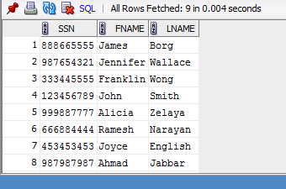
IN Operator
Use the IN operator to test for values in a list:
select ssn,fname,lname
from employee
WHERE Dno IN (1,4,5);

Slide 24
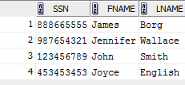
LIKE Operator
Use the LIKE operator to perform wildcard searches of valid search string values.
Search conditions can contain either literal characters or numbers:
% denotes zero or more characters.
_ denotes one character.
select ssn,fname,lname
from employee
WHERE fname LIKE 'J%';

Slide 25
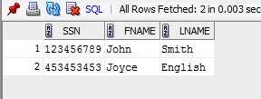
Combining Wildcard Characters
You can combine the two wildcard characters (%, _) with literal characters for pattern matching:
select ssn,fname,lname
from employee
WHERE fname LIKE '_o%';

Slide 26

NULL Conditions
Test for nulls with the IS NULL operator.
select ssn,fname,lname,super_ssn
from employee
WHERE super_SSN is NULL;

Slide 27

AND Operator
AND requires both the component conditions to be true.
select *
from employee
WHERE salary >= 10000
AND Dno = 4;

Slide 28
AND Operator
Binary operator (2 inputs)
Condition1 AND Condition2
True if both Condition1 and Condition2 are true
( ( Condition3 AND Condition4 ) AND Condition5 )
Condition3_and_4 AND Condition5

Slide 29
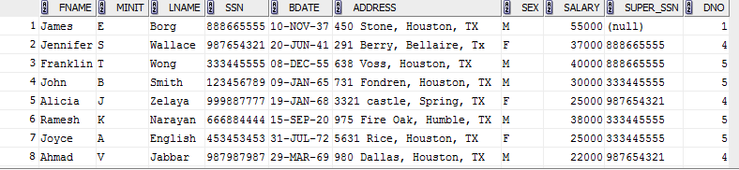
OR Operator
OR requires either component condition to be true:
select *
from employee
WHERE salary >= 10000
OR Dno = 4

Slide 30
OR Operator
Binary operator
Condition1 OR Condition2
True if either Condition1 or Condition2 is true
( ( Condition3 OR Condition4 ) OR Condition5 )
Condition3_or_4 OR Condition5

Slide 31
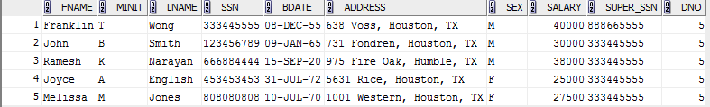
NOT Operator
select *
from employee
WHERE Dno NOT IN (1,4);

Slide 32
NOT Operator
Unary operator
Applies to single condition only
NOT Condition1
True if either Condition1 is false
NOT (NOT Condition2)
Equivalent to Condition2
True if Condition2 is true

Slide 33
Combining AND/OR/NOT
Condition grouping
(Cond1 OR Cond2) AND Cond3
Cond1 OR (Cond2 AND Cond3)
NOT is unary
Cond1 AND NOT Cond2
Cond1 AND (NOT Cond2)

Slide 34
Rules of Precedence
Operator
Meaning
1
Arithmetic operators
2
Concatenation operator
3
Comparison conditions
4
IS [NOT] NULL, LIKE, [NOT] IN
5
[NOT] BETWEEN
6
Not equal to
7
NOT logical operator
8
AND logical operator
9
OR logical operator

Slide 35
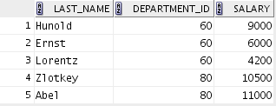

Rules of Precedence
SELECT last_name, department_id, salary
FROM employees
WHERE department_id = 60
OR department_id = 80
AND salary > 10000;
SELECT last_name, department_id, salary
FROM employees
WHERE (department_id = 60
OR department_id = 80)
AND salary > 10000;

Slide 36
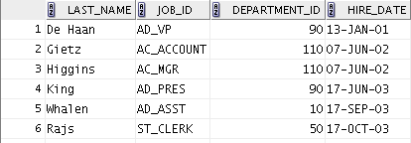
ORDER BY Clause
Sort the retrieved rows with the ORDER BY clause:
ASC: Ascending order, default
DESC: Descending order
SELECT last_name, job_id, department_id, hire_date
FROM employees
ORDER BY hire_date ;

Slide 37
ORDER BY
ORDER BY list of ordering attributes
Tuples returned by the query are sorted by the first attribute in the list
Ties are broken by the second attribute, then the third, et cetera
Tuples are sorted in ascending order unless we put DESC after an attribute
ORDER BY <column*> [ASC|DESC]

Slide 38
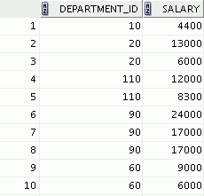


Group Functions
Group functions operate on sets of rows to give one result per group.
EMPLOYEES
Maximum salary in EMPLOYEES table
…

Slide 39
Types of Group Functions
AVG
COUNT
MAX
MIN
SUM
Group
functions

Slide 40
Group Functions: Syntax
SELECT group_function(column), ...
FROM table
[WHERE condition];

Slide 41
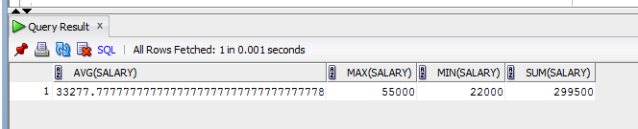
AVG and SUM Functions
You can use AVG and SUM for numeric data.
select AVG(salary), MAX(salary),
MIN(salary), SUM(salary)
FROM employee;

Slide 42
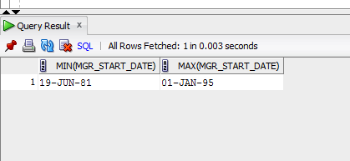
MIN and MAX Functions
You can use MIN and MAX for numeric, character, and date data types
select MIN(Mgr_start_date), MAX(Mgr_start_date)
FROM department;

Slide 43
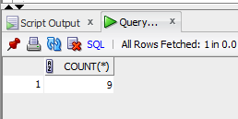
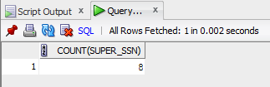
COUNT Function
COUNT(*) returns the number of rows in a table.
COUNT(expr) returns the number of rows with non-null values for expr:
select COUNT(*) from employee;
select COUNT(super_ssn) from
employee;

Slide 44
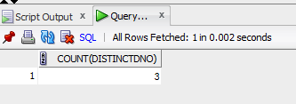
COUNT With DISTINCT
COUNT(DISTINCT expr) returns the number of distinct non-null values of expr.
To display the number of distinct department values in the EMPLOYEES table:
select COUNT(DISTINCT DNO) from
employee;

Slide 45

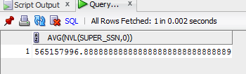
Group Functions and Null Values
Group functions ignore null values in the column
select AVG(super_ssn)
from employee;
select AVG(NVL(super_ssn,0))
from employee;

Slide 46
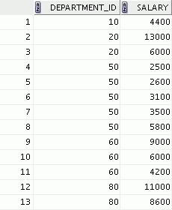
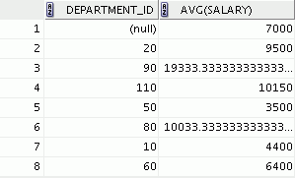

Creating Groups of Data
EMPLOYEES
Average salary in the
EMPLOYEES table for
each department
4400
9500
3500
6400
10033
…

Slide 47
GROUP BY Clause Syntax
You can divide rows in a table into smaller groups by using the GROUP BY clause.
SELECT column, group_function(column)
FROM table
[WHERE condition]
[GROUP BY group_by_expression]
[ORDER BY column];

Slide 48
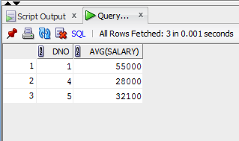
GROUP BY Clause
All the columns in the SELECT list that are not in group functions must be in the GROUP BY clause.
select dno,AVG(salary)
from employee
GROUP BY dno;

Slide 49
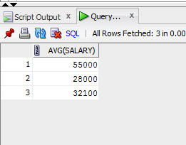
GROUP BY Clause
All the columns in the SELECT list that are not in group functions must be in the GROUP BY clause.
Select AVG(salary)
from employee
GROUP BY dno;

Slide 50
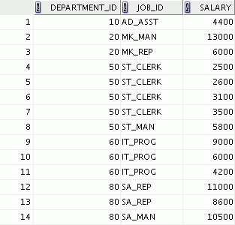
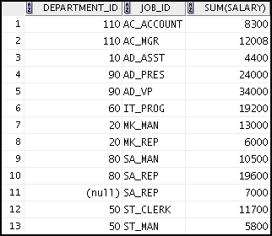

Grouping by More Than One Column
EMPLOYEES
Add the salaries in the EMPLOYEES
table for each job, grouped by department.
…

Slide 51
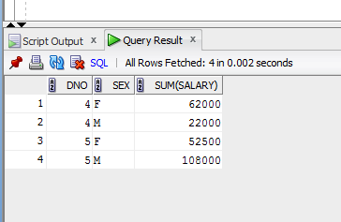
GROUP BY Clause on Multiple Columns
select dno,sex ,SUM(salary) from employee
where dno > 1
GROUP BY dno, sex
ORDER BY dno;

Slide 52
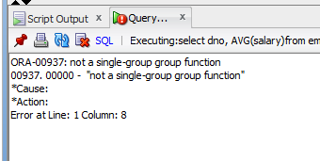
Illegal Queries Using Group Functions
Any column or expression in the SELECT list is not an aggregate function must be in the GROUP BY clause:
select dno, AVG(salary)
from employee;

Slide 53
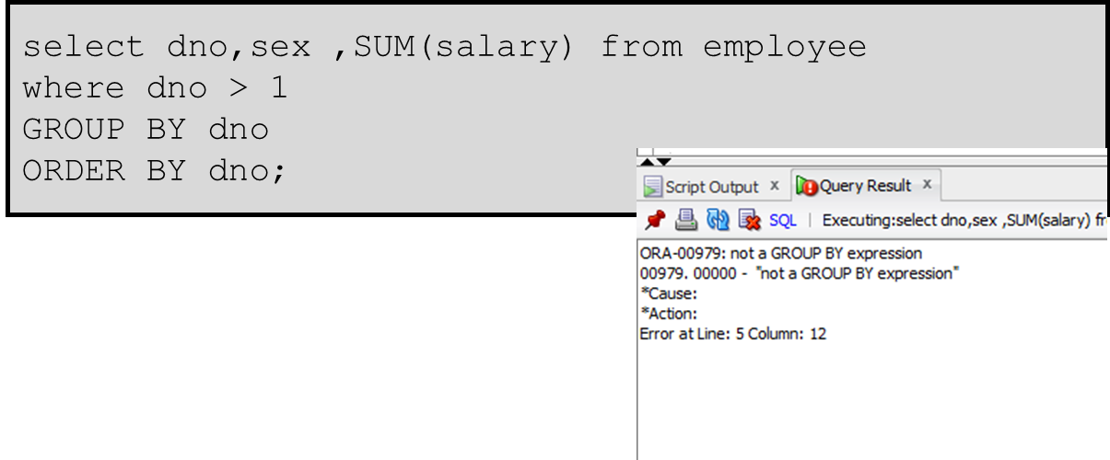
Illegal Queries Using Group Functions

Slide 54
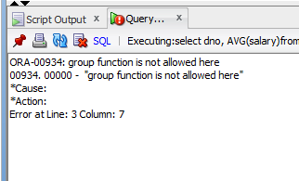
Illegal Queries Using Group Functions
You cannot use the WHERE clause to restrict groups.
You use the HAVING clause to restrict groups.
You cannot use group functions in the WHERE clause
select dno, AVG(salary)
from employee
WHERE AVG(salary) > 20000
GROUP BY dno;

Slide 55
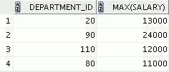
Restricting Group Results
EMPLOYEES
The maximum salary per department when it is
greater than $20,000

Slide 56
Restricting Group Results with the HAVING Clause
When you use the HAVING clause, the Oracle server restricts groups as follows:
Rows are grouped.
The group function is applied.
Groups matching the HAVING clause are displayed.
SELECT column, group_function
FROM table
[WHERE condition]
[GROUP BY group_by_expression]
[HAVING group_condition]
[ORDER BY column];

Slide 57
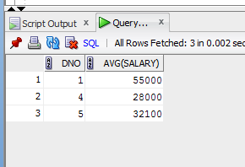
HAVING Clause
select dno, AVG(salary)
from employee
GROUP BY dno
HAVING AVG(salary) > 20000;

Slide 58
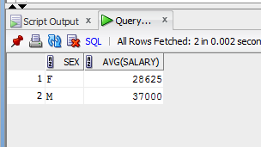
HAVING Clause
select sex, AVG(salary)
from employee
GROUP BY sex
HAVING SUM(salary) > 20000
ORDER BY SUM(salary);

Slide 59
Order of Operations
In what order are these clauses applied?
FROM: Chooses a table
WHERE: Chooses a set of tuples
GROUP BY: Partitions them into groups
HAVING: Chooses some subset of the groups
SELECT: Chooses what columns to display
ORDER BY: Chooses the order to display them

Slide 60
Quiz
Identify the two guidelines for group functions and the GROUP BY clause.
You cannot use a column alias in the GROUP BY clause.
The GROUP BY column must be in the SELECT clause.
By using a WHERE clause, you can exclude rows before dividing them into groups.
The GROUP BY clause groups rows and ensures order of the result set.
If you include a group function in a SELECT clause, you must include a GROUP BY clause.

Slide 61
THANK YOU!!

